Slide 1



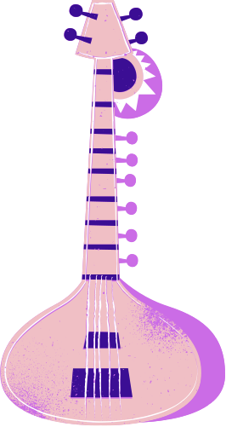



Acing the Clock: Making Non-stop Music in the Elementary Classroom
Presenter: Theresa Lopes-Medina
CASMEC 2025
Maximize music-making & minimize teacher talking, all while embedding music instruction

Slide 2
CASMEC 2025 HANDOUT CLINIC OUTLINE

Slide 3



This Handout Will…
Outline the model lesson
Provide lesson repertoire materials
List tips to maximize music making as demonstrated

Slide 4
Lesson Sequence:
Objective: Students can SING and PLAY the Resting Tone in Major and Minor using solfege “Do” & “La”.
Vocal Warm Up
Ear/Audiation Activity (Major):
  Teacher sings any arpeggiated 2-4 note pitch pattern, (ex “So Mi Do”)
  Student(s) respond by singing only the Resting Tone (tonic/home note) “Do”
Ear/Audiation Activity (minor):
  Teacher sings 2-4 note pitch pattern, “Mi Do La”
  Student(s) respond by singing only the Resting Tone (tonic/home note) “La”
Song #1 “Hola Astur Son”
Song #2 “Bouncy Song
Closing questions/discussion
Teacher:
“So Do Mi”
Student(s): “Do”
Teacher:
“Mi Do La”
Student(s): “La”

Slide 5

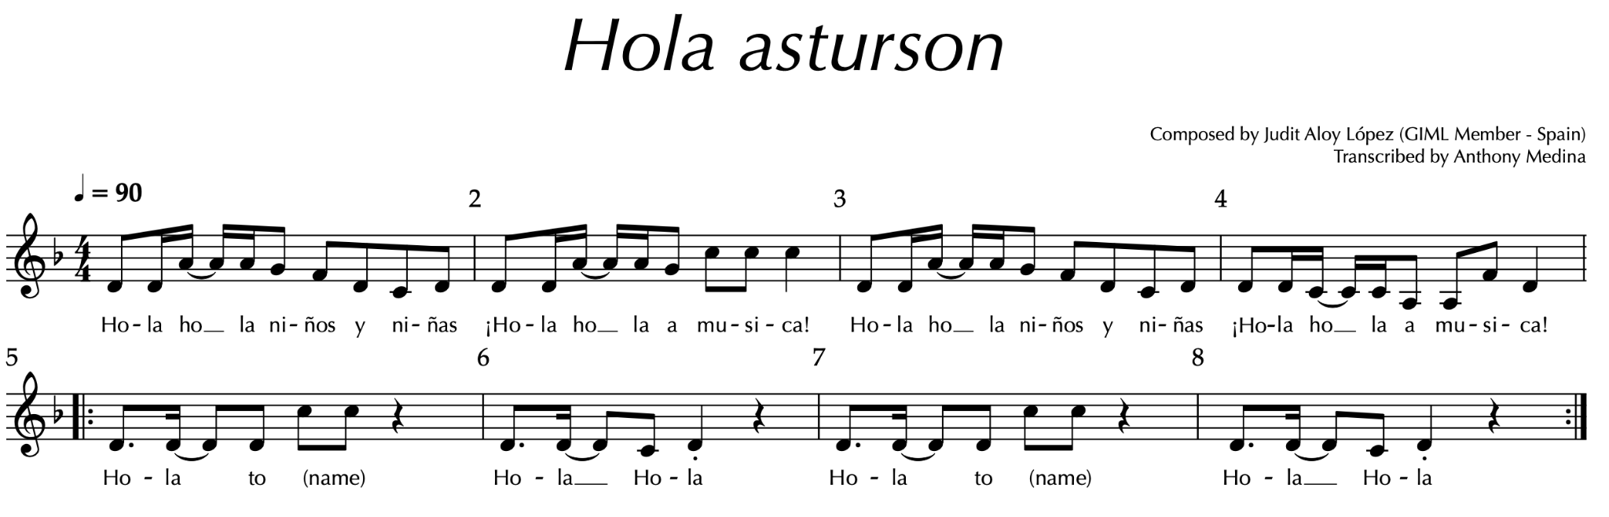
👋🏽
"Hola Hola"
Welcome individuals by name.
Try whole-class response or a solo response.

Slide 6










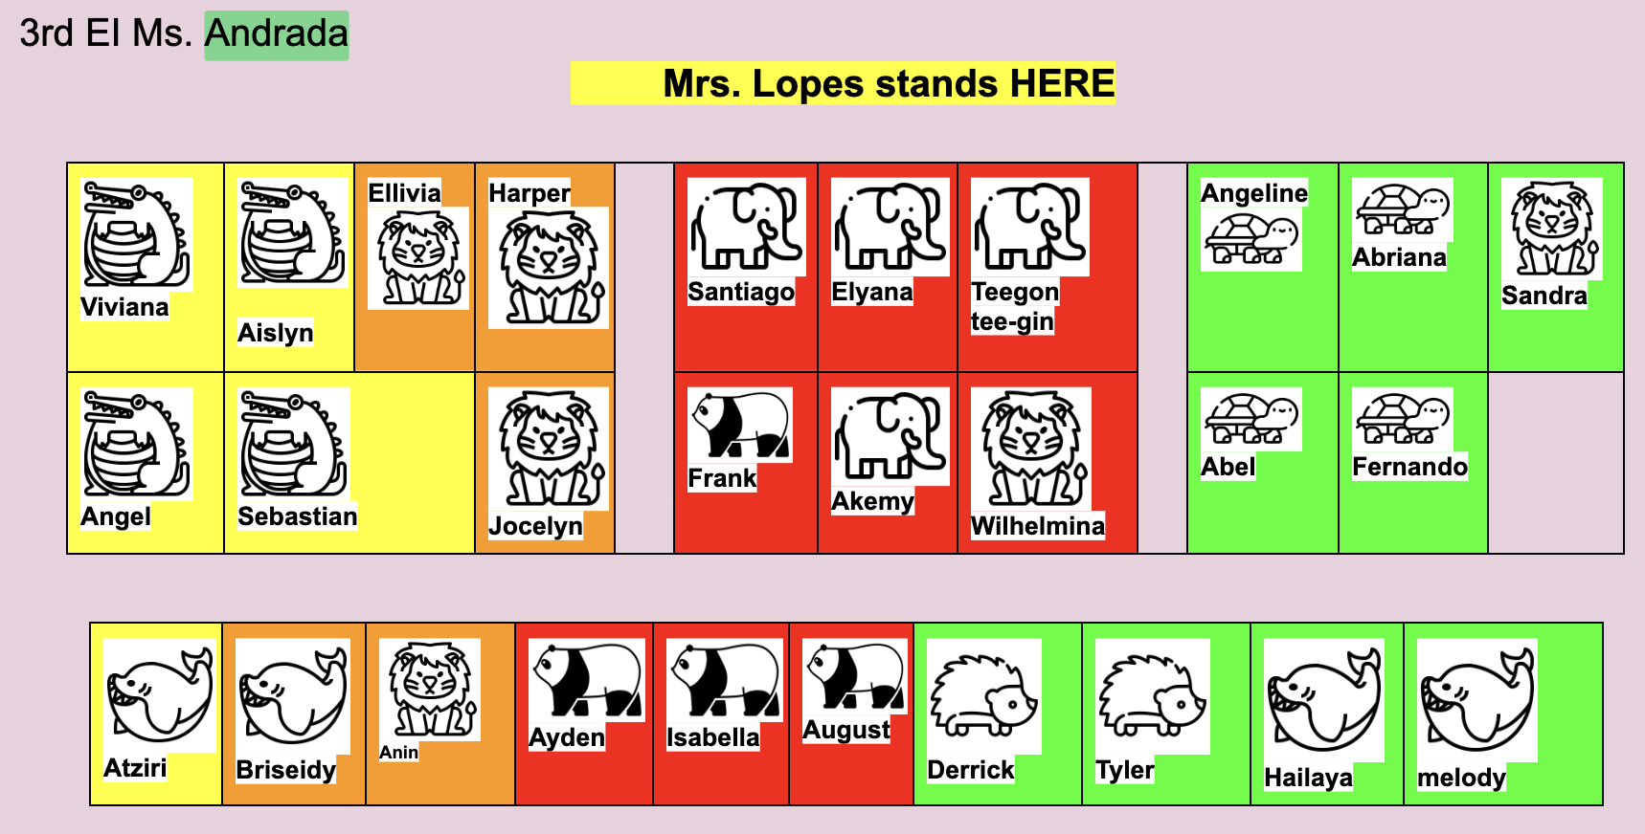
I can SING and PLAY the Resting Tone in Minor tonality using solfege “Do” & “La”.
Ready &
“SET”
^Mallets here^

Slide 7
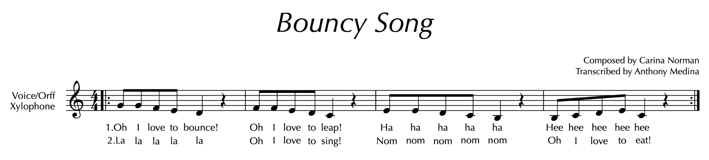

BOUNCY SONG
*The lyrics to this song were written by
Stanislaus Union SD students*

Slide 8



F
E
D
E
D
C
I can SING and PLAY the Resting Tone in Major tonality using solfege “Do” .
A
A
B
B
G
G
F
E
D
C
C
A
B
C
F
F
E
D
C
C
D
E
F
G
A
B
C
D
E
F
G
A
E
E
G
E
E
D
C
B
E
E
B
C
D
E
C
Notes:
NOTE TEMPLATE
TO EDIT PAIRED EIGHTH NOTES: HIGHLIGHT, RIGHT CLICK, SELECT UNGROUP DOUBLE CLICK THE LETTER TO EDIT
WHEN FINISHED HIGHLIGHT, RIGHT CLICK AND GROUP

Slide 9
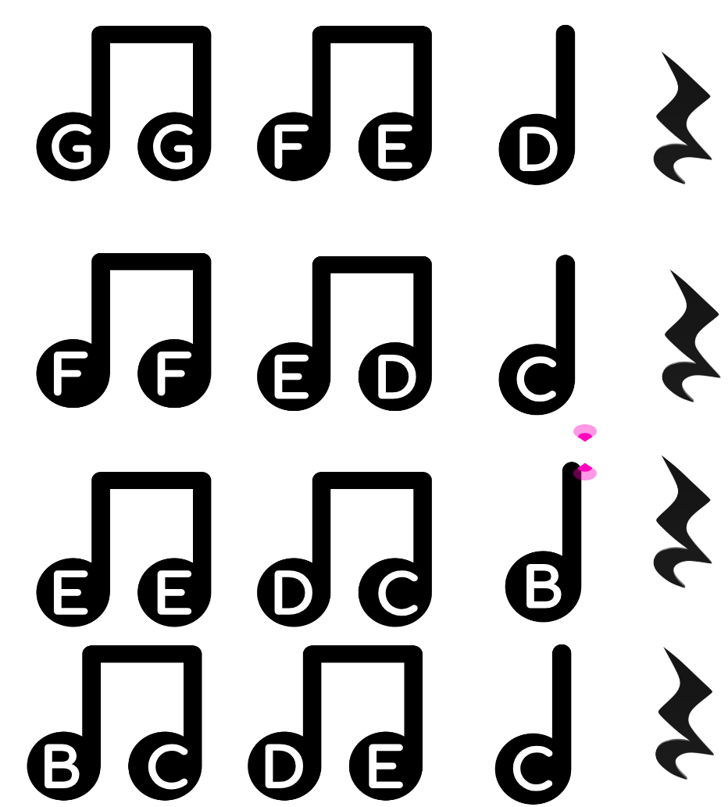
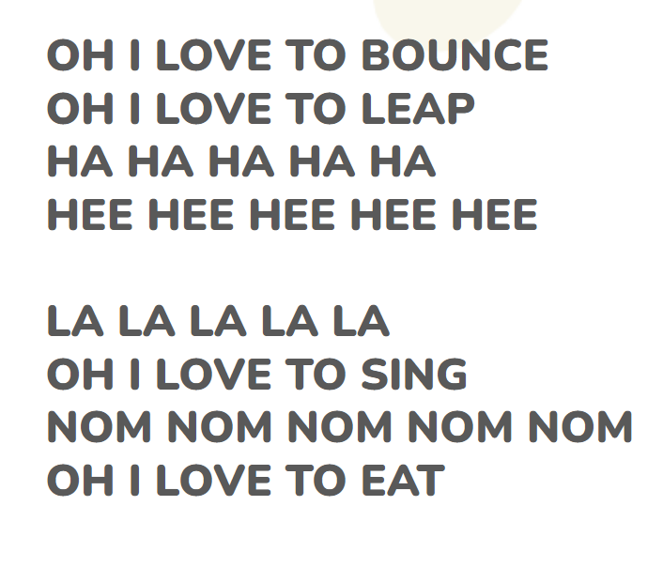
I can SING and PLAY at the SAME TIME.

Slide 10

How to make every moment musical
Rhythmic Routines Echoing routines in rhythm | The best transition is NO TRANSITION | Short, unexpected student solo opportunities will keep ‘em on their toes

Slide 11
Keep Musical Momentum…
Musical transitions ‘Catch’ item/instrument with your voice | Non-speaking cues/instructions | Short, Musical responses from students

Slide 12
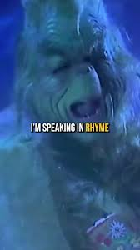
Speak in Rhythm,
Speak in Rhyme

Slide 13


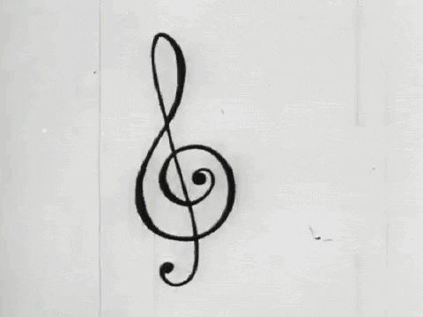

The power of musical cadence
It draws the attention of students
(& humans in general)
when we make our speech musical

Slide 14

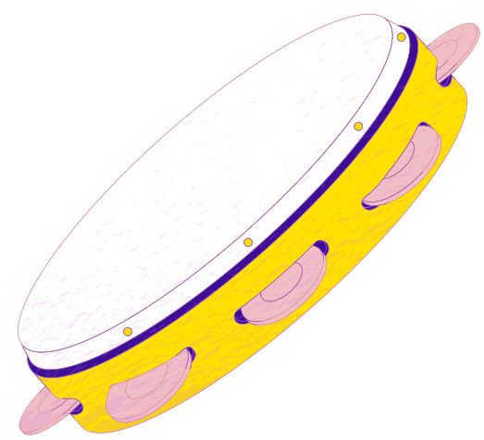
Other elements of today’s presentation:
Audiation-based teaching approach
Duple & triple meters
Major & minor tonalities
Influenced by Dr. Ed Gordon’s research with the Gordon Institute for Music Learning (GIML.org)
Ex: 4/4 vs 6/8
Exposure to contrasting tonalities

Slide 15

Contrast = Increased 👂🏽Aural👂🏽 Engagement
“We understand what something is by comparing it to what it is NOT” ~ Ed Gordon
*Important note*
Assess one thing at a time.
Provide contrast
From birth, children can and should hear contrast
ONLY assess students’ abilities to differentiate major/minor duple/triple AFTER they have shown proficiency to verbalize patterns accurately in each context on NEUTRAL SYLLABLES, then on RHYTHM/SOLFEGE SYLLABLES.
Current research from the Gordon Institute for Music Learning suggests that exposure to contrast improves accuracy of student performance
We know what MAJOR is by hearing its counterpart MINOR.
We know what DUPLE is by hearing its counterpart, TRIPLE.

Slide 16
Contact email for
Theresa (Tess) Lopes-Medina
Letsmakemusic321@gmail.com

